Slide 1

Introduction to Deep Learning
and Reinforcement Learning
Project Proposal

Slide 2
Li, Yansong Qu, Shuzheng Su, Xuanyu Yang, Siyuan Linkletter, Maurice
Team Members

Slide 3

Our team has decided to compete in a SuperGLUE[1] task. The task we selected is Choice Of Plausible Alternatives (COPA) [2]. This task evaluates a model’s commonsense causal reasoning. It is tested with a series of questions where each question gives a premise and two plausible causes or effects. The correct choice is the alternative that is more plausible than the other.
Statement of Problem

Slide 4
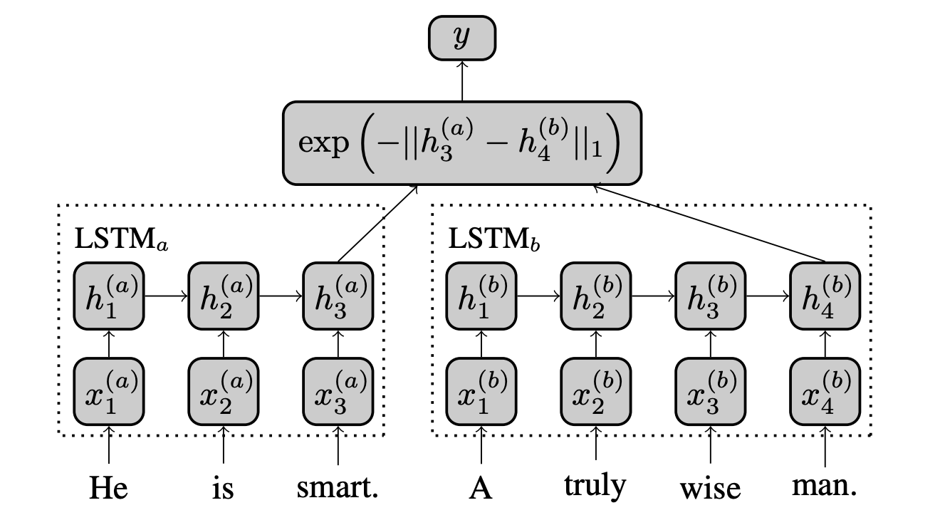
Manhattan LSTM models has two networks LSTM_{left} and LSTM_{right} which process one of the sentences in a given pair independently.
Siamese LSTM [4], a version of Manhattan LSTM where both LSTM_{left} and LSTM_{right} have same tied weights such that LSTM_{left} = LSTM_{right}.
The model uses an LSTM to read in word-vectors representing each input sentence and employs its final hidden state as a vector representation for each sentence. Subsequently, the similarity between these representations is used as a predictor of semantic similarity
Our Approach - Siamese Manhattan LSTM
Figure captured from “Siamese Recurrent Architectures for Learning Sentence Similarity” [4]

Slide 5
Instead of initializing the Siamese networks on our test data (500 questions combined with two answers for each) to directly calculate distance between query and answer, we decide to pre-train the Siamese Manhattan LSTM with SICK data which contains 9,927 sentence pairs with a 5,000/4,927 training/test split ( Each pair is annotated with a relatedness label ∈ [1, 5] corresponding to the average relatedness judged by 10 different individuals).
Then we would use our Siamese Manhattan LSTM trained from step 1 as our classifier to calculate the Manhattan distance between each query with their corresponding answer.
We would pre-process our data based on cause & effect model, which means we would combine question and answer according to the model as our new data format, then we compare the two options in one query:
Exp(Condition = cause, data1 = query1 + answer1, data2 = query1 + answer 2
Condition = effect, data1 = answer1 + query1, data2 = answer2 + query2)
Initial Thoughts

Slide 6
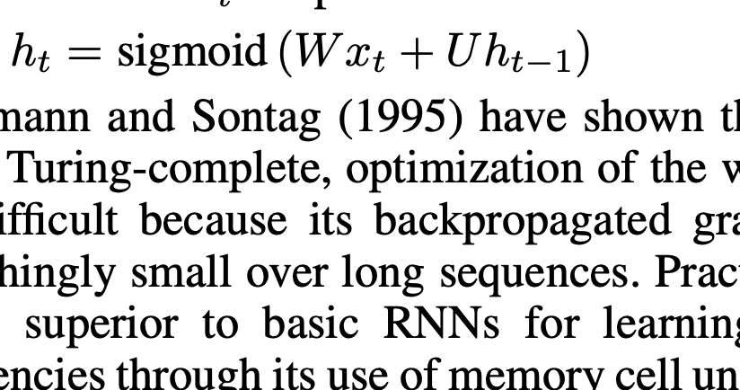
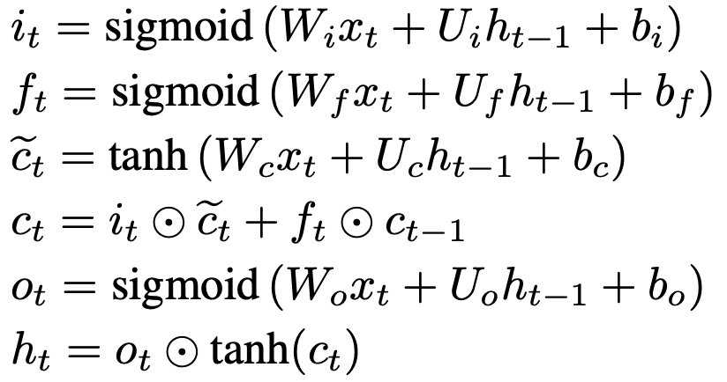
The LSTM learns a mapping from the space of variable length sequences of din-dimensional(Max length of sentences) vectors into R^^{embedding-dimension}(embedding matrix length)
Each sentence (represented as a sequence of word vectors) x₁,...,x_{T} , is passed to the LSTM, which updates its hidden state at each sequence-index via equations:
Note: x(sequence data of sentence), W, U(weight matrix), t(# of hidden layer),
How it works
Figure captured from “Siamese Recurrent Architectures for Learning Sentence Similarity” [4]

Slide 7
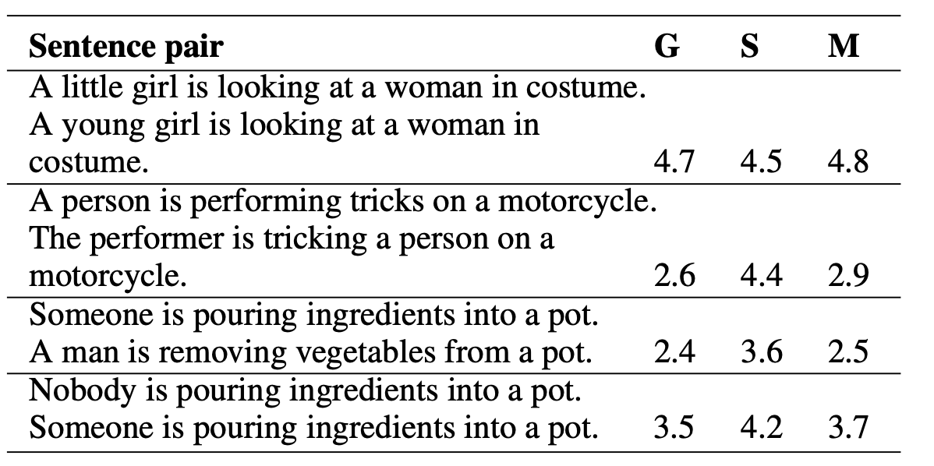
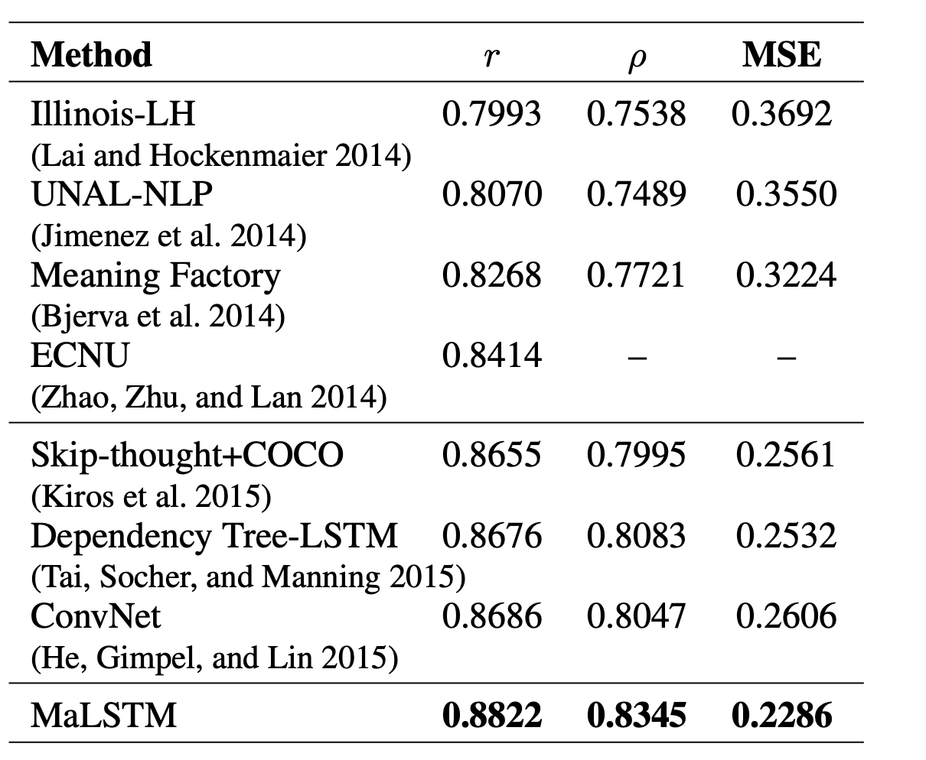
How well it works
Table results captured from “Siamese Recurrent Architectures for Learning Sentence Similarity” [4]
Note: Example sentence pairs from the SICK test data. G denotes ground truth relatedness ∈ [1, 5], S = skip-thought predictions, and M = MaLSTM predictions. R is Pearson correlation (r), p is Spearman’s p.

Slide 8
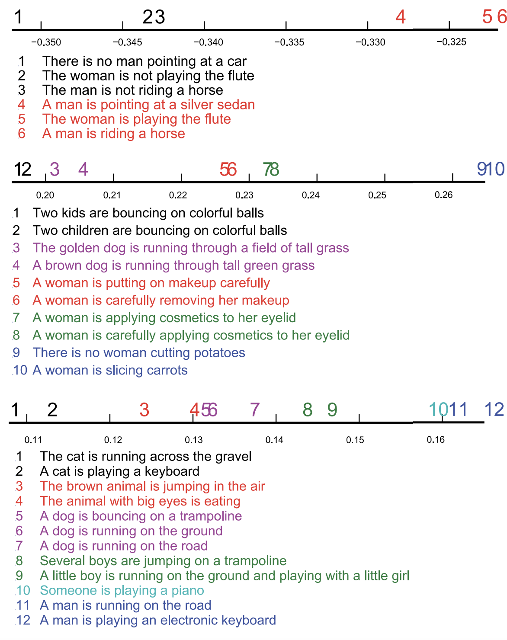
Since our data contains ‘ , ’ special symbol if we combine question and answer together, we need to know how to deal with special symbol in order to not add unnecessary bias.
After plotting sentences into similarity axis, what would be the optimal classifier to correctly the organize the result.
The Loss can be conclude into three part [loss_pretrained model, loss_on_similarity_calculation, loss_on_classification], what would be the best trade off for our loss optimization?
Implementation Thoughts
Figure captured from “Siamese Recurrent Architectures for Learning Sentence Similarity” [4]

Slide 9
Over the last year and a half there been major advancements in natural language processing. Most of these advancements come in the form a pre-trained transferred learning language model (LM). These pre-trained LM(s) provide feature-based extraction using contextual aware word embedding. One such LM is BERT [3], which stands for Bidirectional Encoder Representations from Transformers. The BERT LM has obtained new state-of-the-art results on eleven natural language processing tasks, including the GLUE and SuperGLUE benchmarks. Currently 5 of the top scores on the SuperGLUE leaderboard are using BERT based models. Our team proposes to use the opensource BERT pre-training language model as the basis of our implementation for the COPA task.
Another Approach - BERT

Slide 10
About BERT
The pre-trained BERT language model was made opensource and uploaded to GitHub by Google in 2018. They released a BERT_{Base} and a BERT_{Large}
On the SuperGLUE leader board 5 of top models are using BERT to generate state-of-the-art results.
The initial BERT language model was generated using un-supervised learning on a large amount of text, including books and Wikipedia articles.
The BERT’s model architecture is a multi-layer bidirectional Transformer encoder [3].
BERT_{Base} has 12 transformer, 768 hidden units, and 12 attention head. This resulting in a model with 110M parameters.
BERT_{Large} has 24 transformer, 1024 hidden units, and 16 attention head. This resulting in a model with 340M parameters.

Slide 11
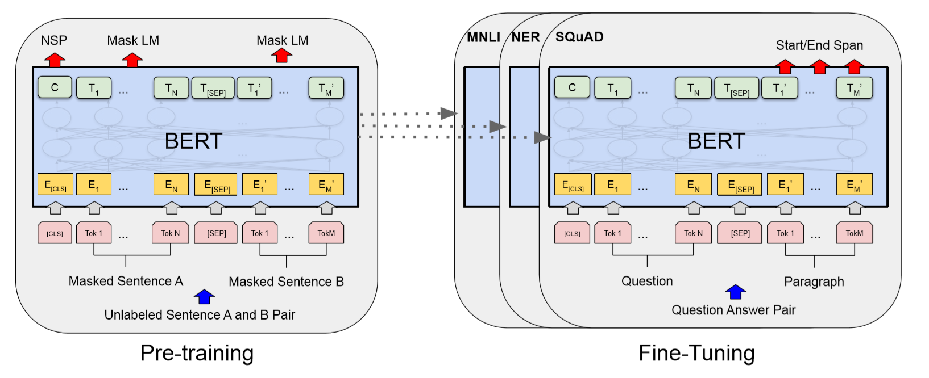
About BERT - Continued
There are two steps to the BERT model: pre-training and ﬁne-tuning. During pre-training, the model is trained on unlabeled data over different pre-training tasks. For ﬁne-tuning, the BERT model is ﬁrst initialized with the pre-trained parameters, and all of the parameters are ﬁne-tuned using labeled data from the downstream tasks. [3]
Figure captured from “BERT: Pre-training of Deep Bidirectional Transformers for Language Understanding ” [3]

Slide 12
Implementation Thoughts
The COPA data is composed of a premise and two plausible causes or effects.
We will pre-process our data similar to how we would for the Siamese LSTM model, except this time we will add [CLS] to the start of the data field, and use [SEP] to separate the premise and the possible cause & effects.
Exp(Condition = cause, data1 = [CLS]query1 [SEP] answer1, data2 = [CLS]query1 [SEP] answer 2
Condition = effect, data1 = [CLS]answer1 [SEP] query1, data2 = [CLS] answer2 [SEP] query2)
BERT will create an contextual aware embedding vector for each word part in the two sentences. It will also create a embedding value for the tokens [CLS] and [SEP] which is based on sentence level embedding.
We then calculate the Euclidean distance between the embedded vectors for the word parts in the two sentences. We also calculate Cosine similarity between the [CLS] and [SEP] sentence level embedding.
We would select the answer that minimizes these values.

Slide 13
Sept 28th: Project group formed. Oct 5th: First group meeting to review project choices. Oct 12th: Second group meeting. Project Selection. Initial self-directed study topics identified. Oct 26th: The team met to discuss 3 possible approaches for the COPA SuperGLUE task. Oct 26th - Oct 30th: Project proposal created with additional research on the three approaches. Nov 1st: Review project proposal with professor. Nov 1st – Nov 15th: Implement our model. Nov 16th – Nov 17th: Our first submission to the SuperGLUE online benchmark. Nov 18th – Dec 1st: Refine model and continue to submit to SuperGLUE. Nov 25th – Dec 2nd: Create project poster. Dec 2nd – Dec 7th: Create project report. Dec 5th: Poster presentation Dec 8th: Report due date
Project Schedule

Slide 14
[1] Alex Wang, Yada Pruksachatkun, Nikita Nangia, Amanpreet Singh, Julian Michael, Felix Hill, Omer Levy, and Samuel R. Bowman. SuperGLUE: A stickier benchmark for general-purpose language understanding systems, 2019. arXiv:1905.00537. [2] Roemmele, M., Bejan, C., and Gordon, A. (2011) Choice of Plausible Alternatives: An Evaluation of Commonsense Causal Reasoning. AAAI Spring Symposium on Logical Formalizations of Commonsense Reasoning, Stanford University, March 21-23, 2011. [3] Devlin, J., Chang, M.-W., Lee, K., and Toutanova, K. Bert: Pre-training of deep bidirectional transformers for language understanding .arXiv preprint arXiv:1810.04805, 2018 [4] Jonas Mueller , Aditya Thyagarajan, Siamese recurrent architectures for learning sentence similarity, Proceedings of the Thirtieth AAAI Conference on Artificial Intelligence, February 12-17, 2016, Phoenix, Arizona
References

